Slide 1
MA3077 (DLI) Operational Research Lecture 10 Networks
Dr Marco Fasondini

Slide 2
Minimal spanning trees and shortest paths
A
7
2
2
5
T
5
4
B
D
O
1
1
3
7
4
C
3
E
Minimal spanning tree problem: Identify a connected subnetwork that contains all the nodes and such that the sum of the weights of the edges included (the total weight) is minimal.
Shortest path problem: Determine a path to join two nodes such that the sum of the weights of the edges included is minimal.

Slide 3
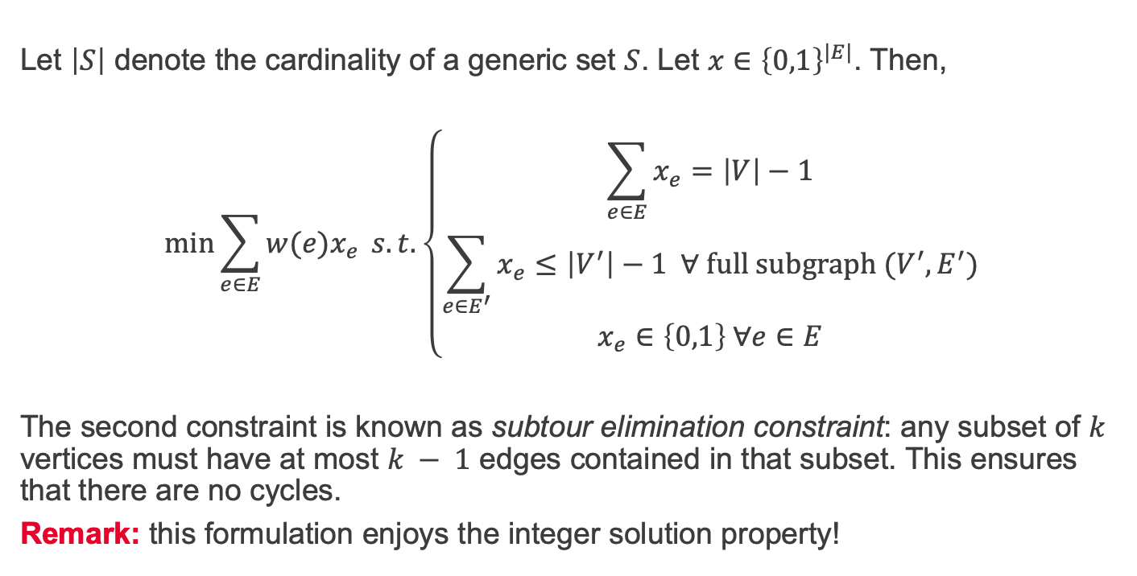
Minimal spanning tree via linear programming
Let $\left|S\right|$ denote the cardinality of a generic set $S$. Let $x∈{\left\{0,1\right\}}^{|E|}$. Then,
$$\min{\sum_{e∈E}{w(e)x_{e}} s.t. \left\{\begin{aligned}\sum_{e∈E}{x_{e}}=\left|V\right|−1 \\ \sum_{e∈E^{′}}{x_{e}}≤\left|V^{′}\right|−1 ∀ full subgraph (V^{′},E^{′}) \\ x_{e}∈\left\{0,1\right\} ∀e∈E\end{aligned}\right.}$$
The second constraint is known as subtour elimination constraint: any subset of $k$ vertices must have at most $k − 1$ edges contained in that subset. This ensures that there are no cycles.
Remark: this formulation enjoys the integer solution property!

Slide 4
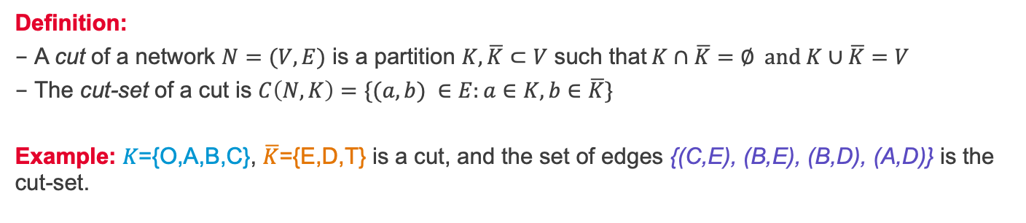
Network cuts
A
7
2
2
5
T
5
4
B
D
O
1
1
3
7
4
C
3
E
Definition:
A cut of a network $N=(V,E)$ is a partition $K, \overline{K}⊂V$ such that$K∩\overline{K}=∅ and K∪\overline{K}=V$
The cut-set of a cut is $C\left(N,K\right)=\{(a,b) ∈E:a∈K,b∈\overline{K}\}$
Example: 𝐾={O,A,B,C}, $\overline{K}$={E,D,T} is a cut, and the set of edges {(C,E), (B,E), (B,D), (A,D)} is the cut-set.

Slide 5
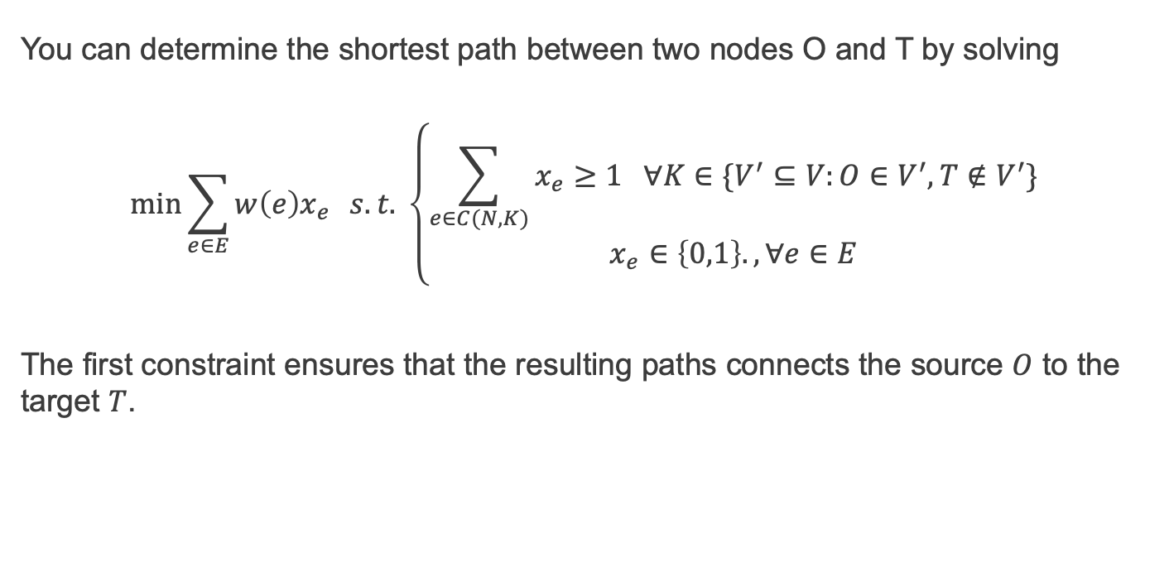
Shortest path via linear programming
You can determine the shortest path between two nodes O and T by solving
$$\min{\sum_{e∈E}{w\left(e\right)x_{e}}} s.t. \left\{\begin{aligned}\sum_{e∈C(N,K)}{x_{e}≥1 ∀K∈\{V^{′}⊆V:O∈V^{′}, T∉V^{′}\}} \\ x_{e}∈\left\{0,1\right\}., ∀e∈E\end{aligned}\right.$$
The first constraint ensures that the resulting paths connects the source $O$ to the target $T$.

Slide 6
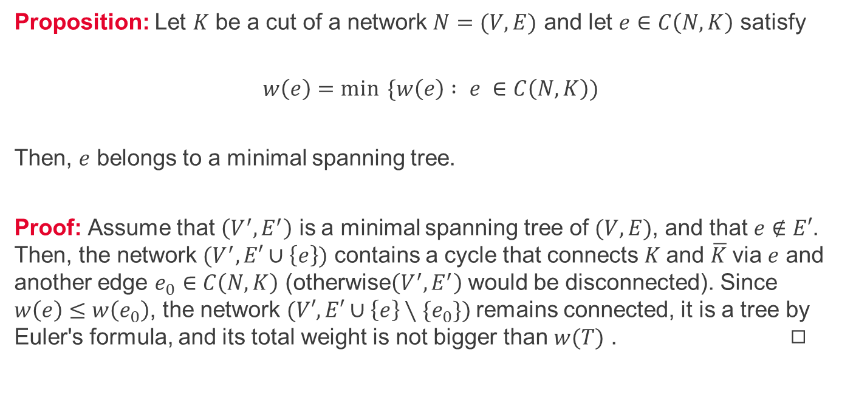
A key property of cuts
Proposition: Let $K$ be a cut of a network $N=(V,E)$ and let $e∈C\left(N,K\right)$ satisfy
$$w\left(e\right)=\min{ \{w\left(e\right) : e }∈C\left(N,K\right))$$
Then, $e$ belongs to a minimal spanning tree.
Proof: Assume that $\left(V^{′}, E^{′}\right)$ is a minimal spanning tree of $(V,E)$, and that $e∉E′$. Then, the network $(V^{′}, E′∪\left\{e\right\})$ contains a cycle that connects $K$and $\overline{K}$via $e$ and another edge $e_{0}∈C\left(N,K\right)$ (otherwise$\left(V^{′}, E^{′}\right)$ would be disconnected). Since $w\left(e\right)≤w\left(e_{0}\right)$, the network $(V′, E′∪\left\{e\right\}∖\{e_{0}\})$remains connected, it is a tree by Euler's formula, and its total weight is not bigger than $w(T)$ . ◻︎

Slide 7
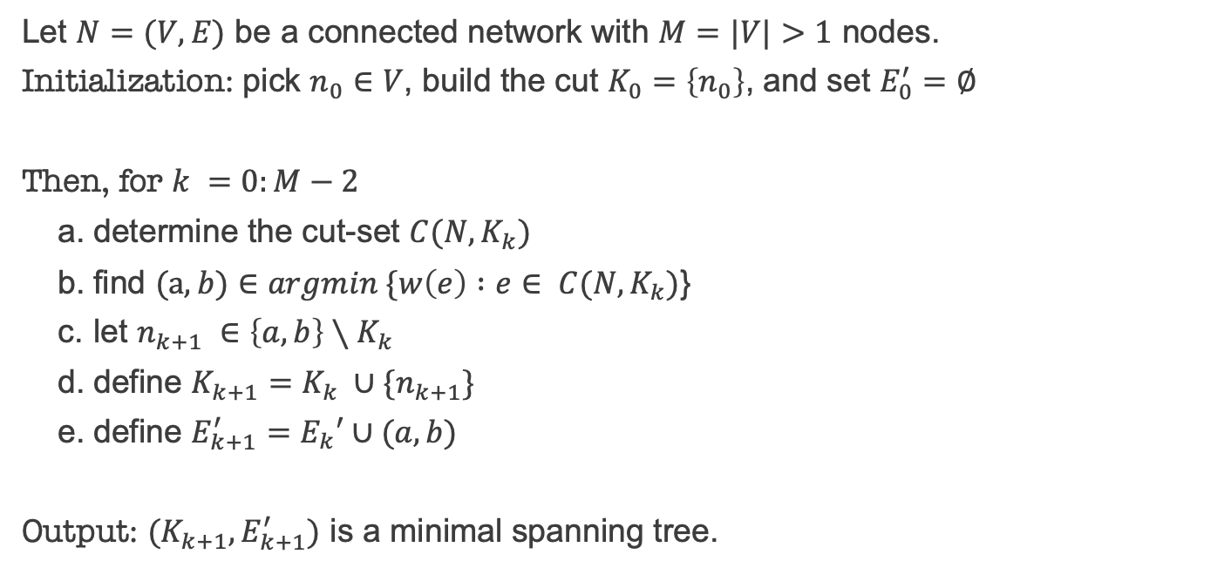
Prim's algorithm (1930, Jarník)
Let $N=(V,E)$ be a connected network with $M=|V|>1$ nodes.
Initialization: pick $n_{0}∈$ $V$, build the cut $K_{0}=\left\{n_{0}\right\}$, and set $E_{0}^{′}=∅$
Then, for $k =0:M−2$
determine the cut-set $C(N,K_{k})$
find $(a,b)∈argmin \{w\left(e\right) :e$ $∈ C(N,K_{k})$}
let $n_{k+1} ∈\left\{a,b\right\}∖K_{k}$
define $K_{k+1}=K_{k} ∪\{n_{k+1}\}$
define $E_{k+1}^{′}=E_{k}′∪(a,b)$
Output: $(K_{k+1}, E_{k+1}^{′})$ is a minimal spanning tree.

Slide 8
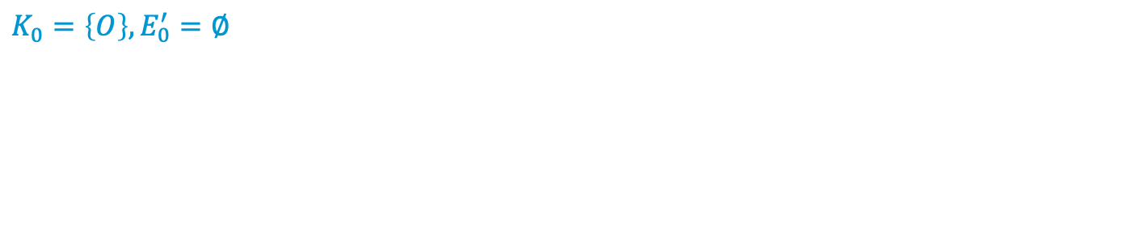
Prim's algorithm – example (step 1)
A
7
2
2
5
T
5
4
B
D
O
1
1
3
7
4
C
3
E
$$K_{0}=\left\{O\right\}, E_{0}^{′}=∅$$

Slide 9
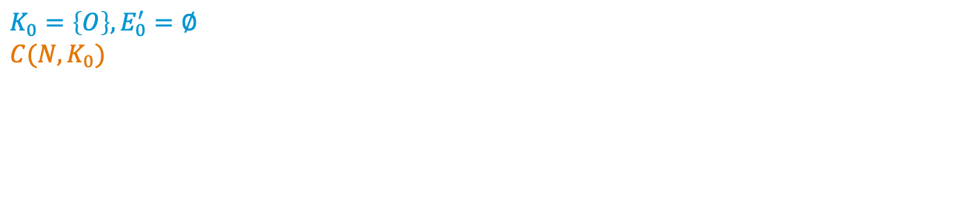
Prim's algorithm – example (step 2)
A
7
2
2
5
T
5
4
B
D
O
1
1
3
7
4
C
3
E
$$K_{0}=\left\{O\right\},E_{0}^{′}=∅ \\ C(N, K_{0})$$

Slide 10
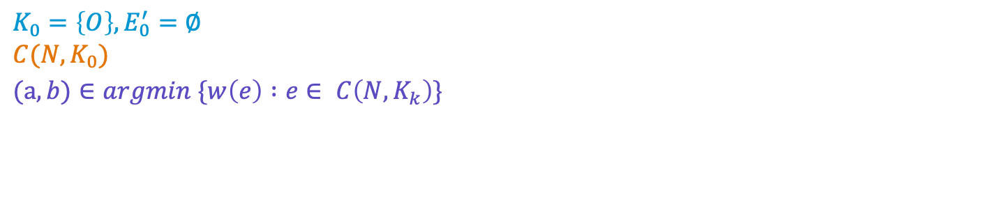
Prim's algorithm - example (step 3)
A
7
2
2
5
T
5
4
B
D
O
1
1
3
7
4
C
3
E
$$K_{0}=\left\{O\right\},E_{0}^{′}=∅ \\ C(N, K_{0})$$
$$(a,b)∈argmin \{w\left(e\right) :e∈ C\left(N,K_{k}\right)\}$$

Slide 11
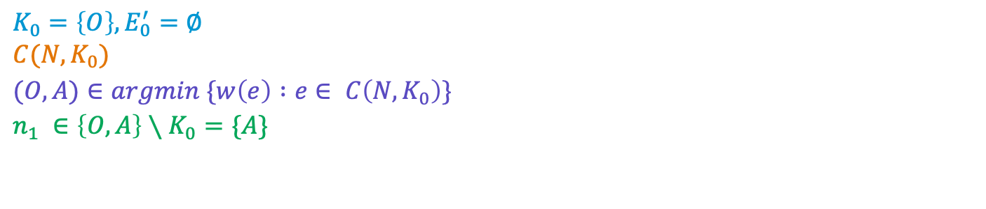
Prim's algorithm - example (step 4)
A
7
2
2
5
T
5
4
B
D
O
1
1
3
7
4
C
3
E
$$K_{0}=\left\{O\right\},E_{0}^{′}=∅ \\ C(N, K_{0})$$
$$(O,A)∈argmin \{w\left(e\right) :e∈ C\left(N,K_{0}\right)\}$$
$$n_{1} ∈\left\{O,A\right\}∖K_{0}=\{A\}$$

Slide 12
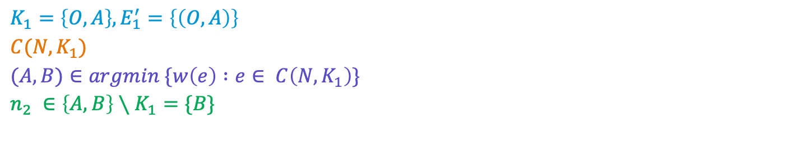
Prim's algorithm - example (step 5)
A
7
2
2
5
T
5
4
B
D
O
1
1
3
7
4
C
3
E
$$K_{1}=\left\{O,A\right\}, E_{1}^{′}=\left\{\left(O,A\right)\right\}$$
$$C(N, K_{1})$$
$$(A,B)∈argmin \{w\left(e\right) :e∈ C\left(N,K_{1}\right)\}$$
$$n_{2} ∈\left\{A,B\right\}∖K_{1}=\{B\}$$

Slide 13
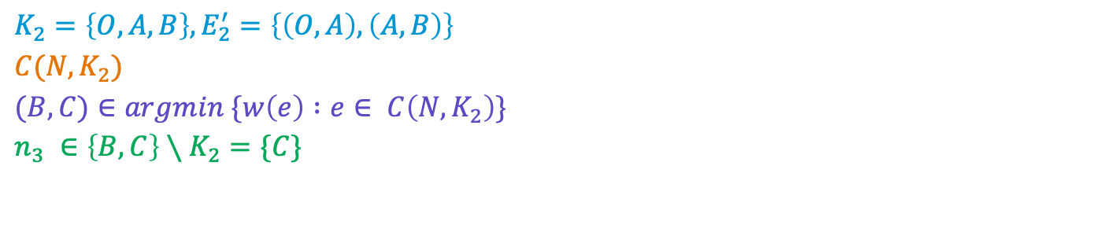
Prim's algorithm - example (step 6)
A
7
2
2
5
T
5
4
B
D
O
1
1
3
7
4
C
3
E
$$K_{2}=\left\{O,A,B\right\}, E_{2}^{′}=\left\{\left(O,A\right), \left(A,B\right)\right\}$$
$$C(N, K_{2})$$
$$(B,C)∈argmin \{w\left(e\right) :e∈ C\left(N,K_{2}\right)\}$$
$$n_{3} ∈\left\{B,C\right\}∖K_{2}=\{C\}$$

Slide 14
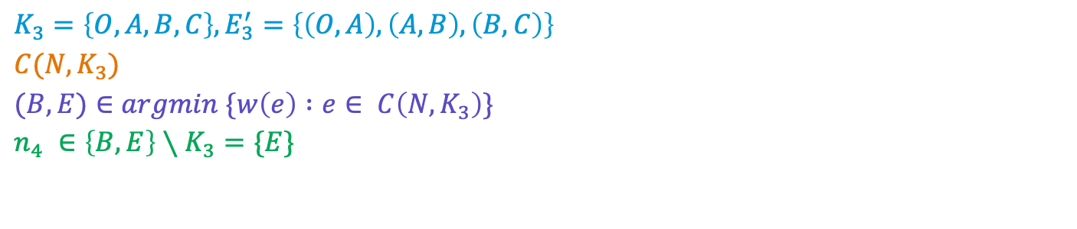
Prim's algorithm - example (step 7)
A
7
2
2
5
T
5
4
B
D
O
1
1
3
7
4
C
3
E
$$K_{3}=\left\{O,A,B,C\right\}, E_{3}^{′}=\left\{\left(O,A\right), \left(A,B\right),\left(B,C\right)\right\}$$
$$C(N, K_{3})$$
$$(B,E)∈argmin \{w\left(e\right) :e∈ C\left(N,K_{3}\right)\}$$
$$n_{4} ∈\left\{B,E\right\}∖K_{3}=\{E\}$$

Slide 15
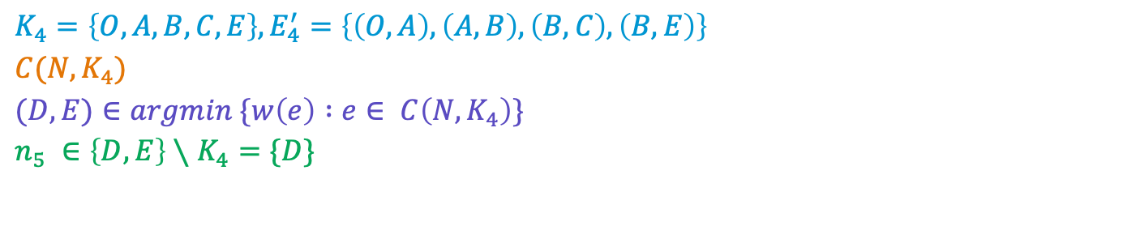
Prim's algorithm - example (step 8)
A
7
2
2
5
T
5
4
B
D
O
1
1
3
7
4
C
3
E
$$K_{4}=\left\{O,A,B,C,E\right\}, E_{4}^{′}=\left\{\left(O,A\right),\left(A,B\right),\left(B,C\right),\left(B,E\right)\right\}$$
$$C(N, K_{4})$$
$$(D,E)∈argmin \{w\left(e\right) :e∈ C\left(N,K_{4}\right)\}$$
$$n_{5} ∈\left\{D,E\right\}∖K_{4}=\{D\}$$

Slide 16
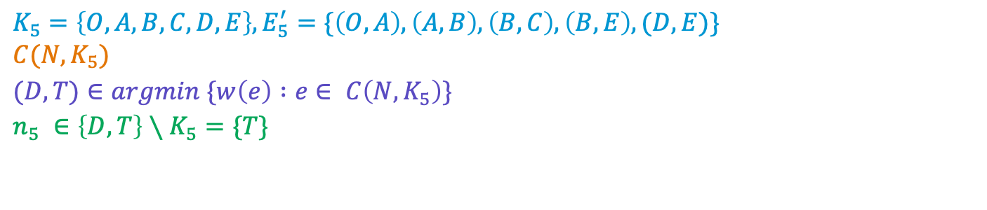
Prim's algorithm - example (step 9)
A
7
2
2
5
T
5
4
B
D
O
1
1
3
7
4
C
3
E
$$K_{5}=\left\{O,A,B,C,D,E\right\},E_{5}^{′}=\{\left(O,A\right), \left(A,B\right),\left(B,C\right),\left(B,E\right),(D,E)\} \\ C(N, K_{5})$$
$$(D,T)∈argmin \{w\left(e\right) :e∈ C\left(N,K_{5}\right)\}$$
$$n_{5} ∈\left\{D,T\right\}∖K_{5}=\{T\}$$

Slide 17
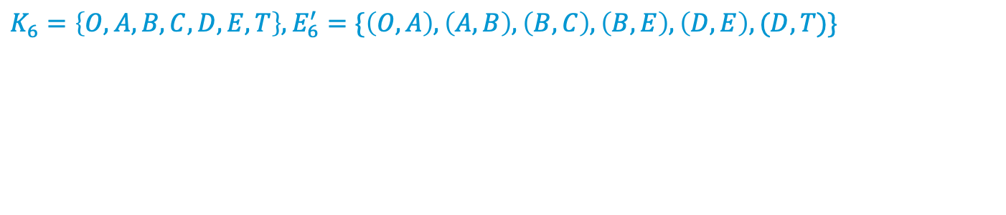
Prim's algorithm – example (step 10)
A
7
2
2
5
T
5
4
B
D
O
1
1
3
7
4
C
3
E
$$K_{6}=\left\{O,A,B,C,D,E,T\right\},E_{6}^{′}=\{\left(O,A\right), \left(A,B\right),\left(B,C\right),\left(B,E\right),\left(D,E\right),(D,T)\}$$

Slide 18
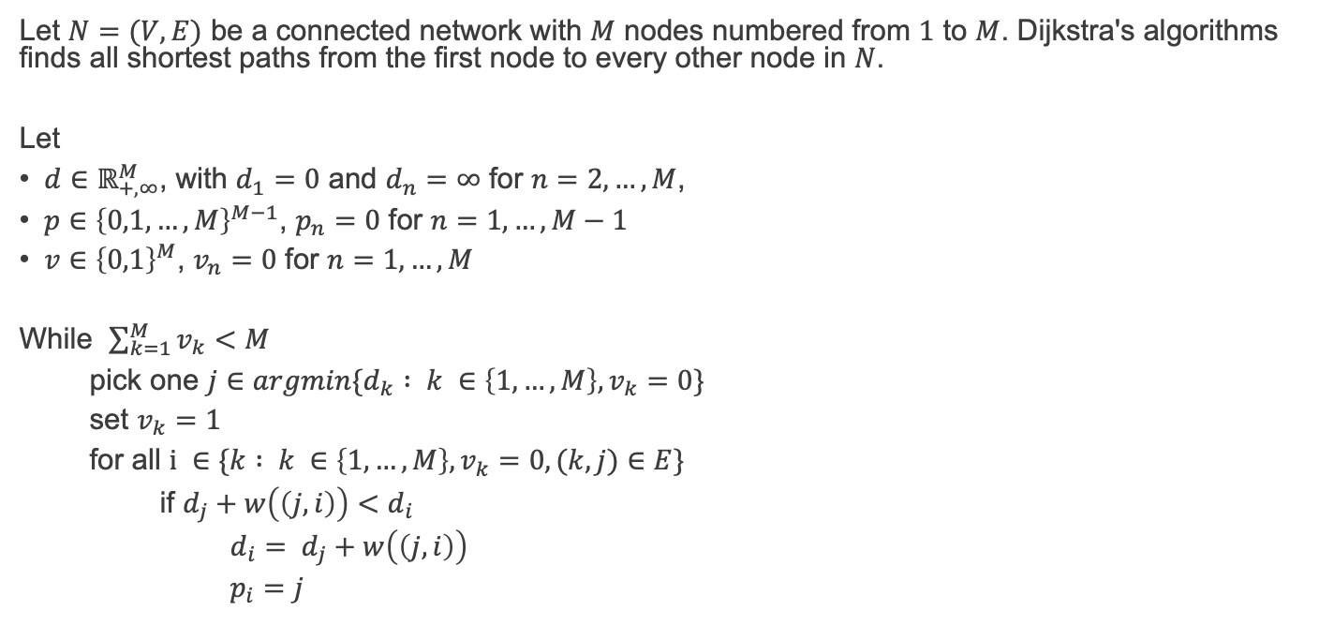
Dijkstra's algorithm (1956)
Let $N=(V,E)$ be a connected network with $M$ nodes numbered from $1$ to $M$. Dijkstra's algorithms finds all shortest paths from the first node to every other node in $N$.
Let
$d∈ℝ_{+,∞}^{M}$, with $d_{1}=0$ and $d_{n}=$ $∞$ for $n=2, …, M$,
$p∈{\left\{0,1, …, M\right\}}^{M−1}$, $p_{n}=$ $0$ for $n=1, …, M−1$
$v∈{\left\{0,1\right\}}^{M}$, $v_{n}=$ $0$ for $n=1, …, M$
While $\sum_{k=1}^{M}{v_{k}}<M$
pick one $j∈argmin\{d_{k} : k ∈\left\{1,…,M\right\}, v_{k}=0\}$
set $v_{k}=1$
for all $i ∈\{k : k ∈\left\{1,…,M\right\},v_{k}=0, (k,j)∈E\}$
if $d_{j}+w\left(\left(j,i\right)\right)<d_{i}$
$d_{i}= d_{j}+w\left(\left(j,i\right)\right)$
$p_{i}=j$

Slide 19
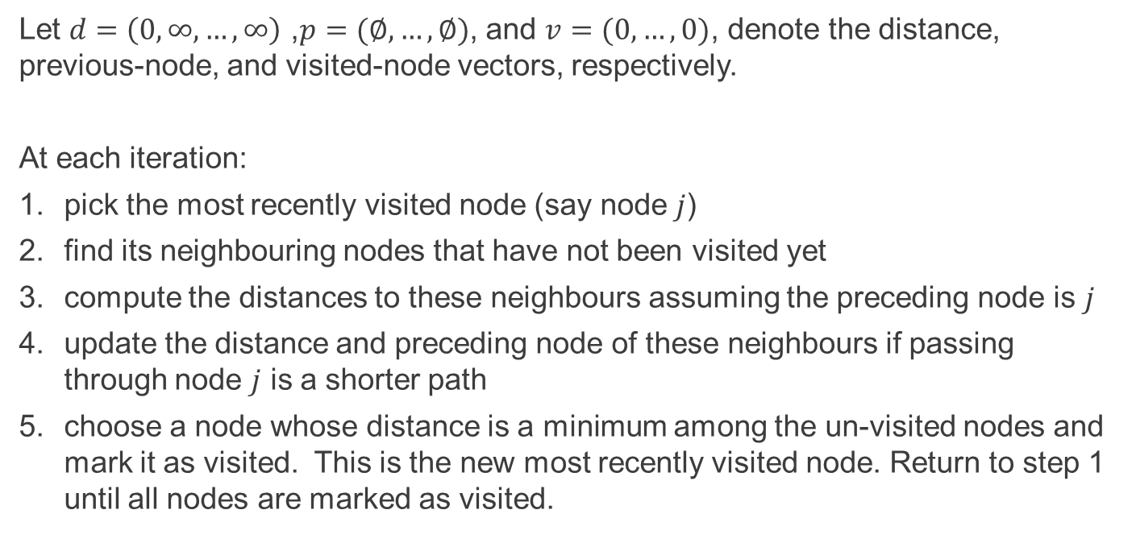
Dijkstra's algorithm (1956) in lay terms
Let $d=\left(0,∞,…,∞\right)$ ,$p=(∅, …, ∅)$, and $v=(0,…,0)$, denote the distance, previous-node, and visited-node vectors, respectively.
At each iteration:
pick the most recently visited node (say node $j$)
find its neighbouring nodes that have not been visited yet
compute the distances to these neighbours assuming the preceding node is $j$
update the distance and preceding node of these neighbours if passing through node $j$ is a shorter path
choose a node whose distance is a minimum among the un-visited nodes and mark it as visited. This is the new most recently visited node. Return to step 1 until all nodes are marked as visited.

Slide 20
Dijkstra's algorithm – example (step 1)
A
7
2
2
5
T
5
4
B
D
O
1
1
3
7
4
C
3
E
$\begin{matrix} & & d & p & v \\ O & 1 & 0 & & 0 \\ A & 2 & ∞ & 0 & 0 \\ B & 3 & ∞ & 0 & 0 \\ C & 4 & ∞ & 0 & 0 \\ D & 5 & ∞ & 0 & 0 \\ E & 6 & ∞ & 0 & 0 \\ T & 7 & ∞ & 0 & 0\end{matrix}$

Slide 21
Dijkstra's algorithm – example (step 2)
A
7
2
2
5
T
5
4
B
D
O
1
1
3
7
4
C
3
E
$\begin{matrix} & & d & p & v \\ O & 1 & 0 & & 0 \\ A & 2 & ∞ & 0 & 0 \\ B & 3 & ∞ & 0 & 0 \\ C & 4 & ∞ & 0 & 0 \\ D & 5 & ∞ & 0 & 0 \\ E & 6 & ∞ & 0 & 0 \\ T & 7 & ∞ & 0 & 0\end{matrix}$ $j∈argmin\left\{d_{k} : k ∈\left\{1,…,M\right\}, v_{k}=0\right\}=\left\{1\right\}$

Slide 22
Dijkstra's algorithm – example (step 3)
A
7
2
2
5
T
5
4
B
D
O
1
1
3
7
4
C
3
E
$\begin{matrix} & & d & p & v \\ O & 1 & 0 & & 1 \\ A & 2 & ∞ & 0 & 0 \\ B & 3 & ∞ & 0 & 0 \\ C & 4 & ∞ & 0 & 0 \\ D & 5 & ∞ & 0 & 0 \\ E & 6 & ∞ & 0 & 0 \\ T & 7 & ∞ & 0 & 0\end{matrix}$ $\begin{matrix}j∈argmin\left\{d_{k} : k ∈\left\{1,…,M\right\}, v_{k}=0\right\}=\left\{1\right\} \\ v_{j}=1\end{matrix}$

Slide 23
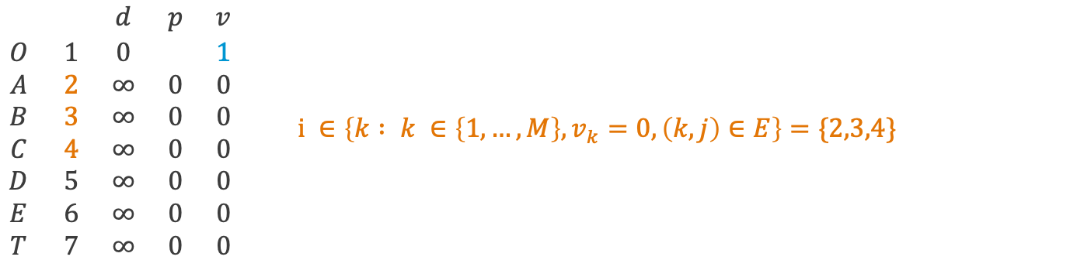
Dijkstra's algorithm – example (step 4)
A
7
2
2
5
T
5
4
B
D
O
1
1
3
7
4
C
3
E
$\begin{matrix} & & d & p & v \\ O & 1 & 0 & & 1 \\ A & 2 & ∞ & 0 & 0 \\ B & 3 & ∞ & 0 & 0 \\ C & 4 & ∞ & 0 & 0 \\ D & 5 & ∞ & 0 & 0 \\ E & 6 & ∞ & 0 & 0 \\ T & 7 & ∞ & 0 & 0\end{matrix}$ $i ∈\left\{k : k ∈\left\{1,…,M\right\},v_{k}=0, \left(k,j\right)∈E\right\}=\{2,3,4\}$

Slide 24
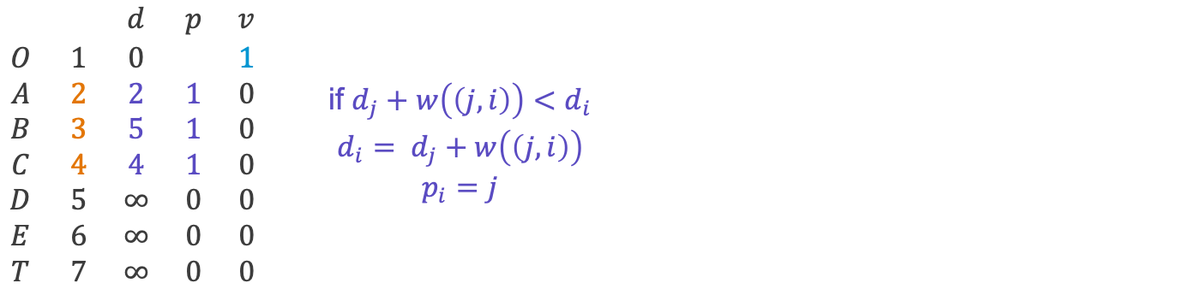
Dijkstra's algorithm – example (step 5)
A
7
2
2
5
T
5
4
B
D
O
1
1
3
7
4
C
3
E
$\begin{matrix} & & d & p & v \\ O & 1 & 0 & & 1 \\ A & 2 & 2 & 1 & 0 \\ B & 3 & 5 & 1 & 0 \\ C & 4 & 4 & 1 & 0 \\ D & 5 & ∞ & 0 & 0 \\ E & 6 & ∞ & 0 & 0 \\ T & 7 & ∞ & 0 & 0\end{matrix}$ $\begin{matrix}\text{if} d_{j}+w\left(\left(j,i\right)\right)<d_{i} \\ d_{i}= d_{j}+w\left(\left(j,i\right)\right) \\ p_{i}=j\end{matrix}$

Slide 25
Dijkstra's algorithm – example (step 6)
A
7
2
2
5
T
5
4
B
D
O
1
1
3
7
4
C
3
E
$\begin{matrix} & & d & p & v \\ O & 1 & 0 & & 1 \\ A & 2 & 2 & 1 & 0 \\ B & 3 & 5 & 1 & 0 \\ C & 4 & 4 & 1 & 0 \\ D & 5 & ∞ & 0 & 0 \\ E & 6 & ∞ & 0 & 0 \\ T & 7 & ∞ & 0 & 0\end{matrix}$ $j∈argmin\left\{d_{k} : k ∈\left\{1,…,M\right\}, v_{k}=0\right\}=\left\{2\right\}$

Slide 26
Dijkstra's algorithm – example (step 7)
A
7
2
2
5
T
5
4
B
D
O
1
1
3
7
4
C
3
E
$\begin{matrix} & & d & p & v \\ O & 1 & 0 & & 1 \\ A & 2 & 2 & 1 & 1 \\ B & 3 & 5 & 1 & 0 \\ C & 4 & 4 & 1 & 0 \\ D & 5 & ∞ & 0 & 0 \\ E & 6 & ∞ & 0 & 0 \\ T & 7 & ∞ & 0 & 0\end{matrix}$ $\begin{matrix}j∈argmin\left\{d_{k} : k ∈\left\{1,…,M\right\}, v_{k}=0\right\}=\left\{2\right\} \\ v_{j}=1\end{matrix}$

Slide 27
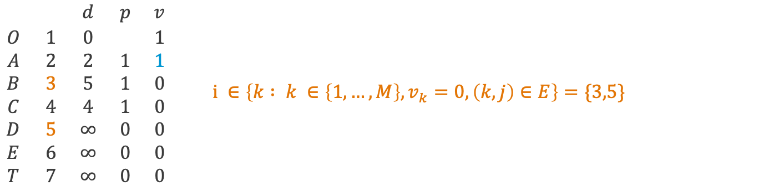
Dijkstra's algorithm – example (step 8)
A
7
2
2
5
T
5
4
B
D
O
1
1
3
7
4
C
3
E
$\begin{matrix} & & d & p & v \\ O & 1 & 0 & & 1 \\ A & 2 & 2 & 1 & 1 \\ B & 3 & 5 & 1 & 0 \\ C & 4 & 4 & 1 & 0 \\ D & 5 & ∞ & 0 & 0 \\ E & 6 & ∞ & 0 & 0 \\ T & 7 & ∞ & 0 & 0\end{matrix}$ $i ∈\left\{k : k ∈\left\{1,…,M\right\},v_{k}=0, \left(k,j\right)∈E\right\}=\{3,5\}$

Slide 28
Dijkstra's algorithm – example (step 9)
A
7
2
2
5
T
5
4
B
D
O
1
1
3
7
4
C
3
E
$\begin{matrix} & & d & p & v \\ O & 1 & 0 & & 1 \\ A & 2 & 2 & 1 & 1 \\ B & 3 & 2+2 & 2 & 0 \\ C & 4 & 4 & 1 & 0 \\ D & 5 & 2+7 & 2 & 0 \\ E & 6 & ∞ & 0 & 0 \\ T & 7 & ∞ & 0 & 0\end{matrix}$ $\begin{matrix}\text{if} d_{j}+w\left(\left(j,i\right)\right)<d_{i} \\ d_{i}= d_{j}+w\left(\left(j,i\right)\right) \\ p_{i}=j\end{matrix}$

Slide 29
Dijkstra's algorithm – example (step 10)
A
7
2
2
5
T
5
4
B
D
O
1
1
3
7
4
C
3
E
$\begin{matrix} & & d & p & v \\ O & 1 & 0 & & 1 \\ A & 2 & 2 & 1 & 1 \\ B & 3 & 4 & 2 & 0 \\ C & 4 & 4 & 1 & 0 \\ D & 5 & 9 & 2 & 0 \\ E & 6 & ∞ & 0 & 0 \\ T & 7 & ∞ & 0 & 0\end{matrix}$ $j∈argmin\left\{d_{k} : k ∈\left\{1,…,M\right\}, v_{k}=0\right\}=\left\{3,4\right\}$

Slide 30
Dijkstra's algorithm – example (step 11)
A
7
2
2
5
T
5
4
B
D
O
1
1
3
7
4
C
3
E
$\begin{matrix} & & d & p & v \\ O & 1 & 0 & & 1 \\ A & 2 & 2 & 1 & 1 \\ B & 3 & 4 & 2 & 1 \\ C & 4 & 4 & 1 & 0 \\ D & 5 & 9 & 2 & 0 \\ E & 6 & ∞ & 0 & 0 \\ T & 7 & ∞ & 0 & 0\end{matrix}$ $\begin{matrix}j∈argmin\left\{d_{k} : k ∈\left\{1,…,M\right\}, v_{k}=0\right\}=\left\{1\right\} \\ v_{j}=1\end{matrix}$

Slide 31
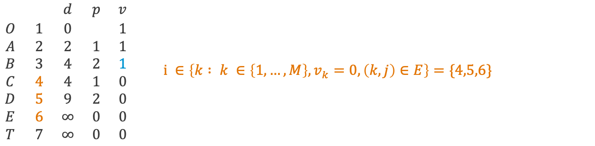
Dijkstra's algorithm – example (step 12)
A
7
2
2
5
T
5
4
B
D
O
1
1
3
7
4
C
3
E
$\begin{matrix} & & d & p & v \\ O & 1 & 0 & & 1 \\ A & 2 & 2 & 1 & 1 \\ B & 3 & 4 & 2 & 1 \\ C & 4 & 4 & 1 & 0 \\ D & 5 & 9 & 2 & 0 \\ E & 6 & ∞ & 0 & 0 \\ T & 7 & ∞ & 0 & 0\end{matrix}$ $i ∈\left\{k : k ∈\left\{1,…,M\right\},v_{k}=0, \left(k,j\right)∈E\right\}=\{4,5,6\}$

Slide 32
Dijkstra's algorithm – example (step 13)
A
7
2
2
5
T
5
4
B
D
O
1
1
3
7
4
C
3
E
$\begin{matrix} & & d & p & v \\ O & 1 & 0 & & 1 \\ A & 2 & 2 & 1 & 1 \\ B & 3 & 4 & 2 & 1 \\ C & 4 & 4 & 1 & 0 \\ D & 5 & 4+4 & 3 & 0 \\ E & 6 & 4+3 & 3 & 0 \\ T & 7 & ∞ & 0 & 0\end{matrix}$ $\begin{matrix}\text{if} d_{j}+w\left(\left(j,i\right)\right)<d_{i} \\ d_{i}= d_{j}+w\left(\left(j,i\right)\right) \\ p_{i}=j\end{matrix}$

Slide 33
Dijkstra's algorithm – example (step 14)
A
7
2
2
5
T
5
4
B
D
O
1
1
3
7
4
C
3
E
$\begin{matrix} & & d & p & v \\ O & 1 & 0 & & 1 \\ A & 2 & 2 & 1 & 1 \\ B & 3 & 4 & 2 & 1 \\ C & 4 & 4 & 1 & 0 \\ D & 5 & 8 & 3 & 0 \\ E & 6 & 7 & 3 & 0 \\ T & 7 & ∞ & 0 & 0\end{matrix}$ $j∈argmin\left\{d_{k} : k ∈\left\{1,…,M\right\}, v_{k}=0\right\}=\left\{4\right\}$

Slide 34
Dijkstra's algorithm – example (step 15)
A
7
2
2
5
T
5
4
B
D
O
1
1
3
7
4
C
3
E
$\begin{matrix} & & d & p & v \\ O & 1 & 0 & & 1 \\ A & 2 & 2 & 1 & 1 \\ B & 3 & 4 & 2 & 1 \\ C & 4 & 4 & 1 & 1 \\ D & 5 & 8 & 3 & 0 \\ E & 6 & 7 & 3 & 0 \\ T & 7 & ∞ & 0 & 0\end{matrix}$ $\begin{matrix}j∈argmin\left\{d_{k} : k ∈\left\{1,…,M\right\}, v_{k}=0\right\}=\left\{4\right\} \\ v_{j}=1\end{matrix}$

Slide 35
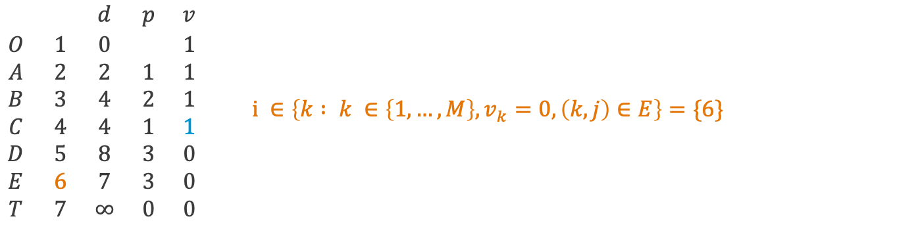
Dijkstra's algorithm – example (step 16)
A
7
2
2
5
T
5
4
B
D
O
1
1
3
7
4
C
3
E
$\begin{matrix} & & d & p & v \\ O & 1 & 0 & & 1 \\ A & 2 & 2 & 1 & 1 \\ B & 3 & 4 & 2 & 1 \\ C & 4 & 4 & 1 & 1 \\ D & 5 & 8 & 3 & 0 \\ E & 6 & 7 & 3 & 0 \\ T & 7 & ∞ & 0 & 0\end{matrix}$ $i ∈\left\{k : k ∈\left\{1,…,M\right\},v_{k}=0, \left(k,j\right)∈E\right\}=\{6\}$

Slide 36
Dijkstra's algorithm – example (step 17)
A
7
2
2
5
T
5
4
B
D
O
1
1
3
7
4
C
3
E
$\begin{matrix} & & d & p & v \\ O & 1 & 0 & & 1 \\ A & 2 & 2 & 1 & 1 \\ B & 3 & 4 & 2 & 1 \\ C & 4 & 4 & 1 & 1 \\ D & 5 & 8 & 3 & 0 \\ E & 6 & 7 & 3 & 0 \\ T & 7 & ∞ & 0 & 0\end{matrix}$ $\begin{matrix}\text{if} d_{j}+w\left(\left(j,i\right)\right)<d_{i} \\ d_{i}= d_{j}+w\left(\left(j,i\right)\right) \\ p_{i}=j\end{matrix}$

Slide 37
Dijkstra's algorithm – example (step 18)
A
7
2
2
5
T
5
4
B
D
O
1
1
3
7
4
C
3
E
$\begin{matrix} & & d & p & v \\ O & 1 & 0 & & 1 \\ A & 2 & 2 & 1 & 1 \\ B & 3 & 4 & 2 & 1 \\ C & 4 & 4 & 1 & 1 \\ D & 5 & 8 & 3 & 0 \\ E & 6 & 7 & 3 & 1 \\ T & 7 & ∞ & 0 & 0\end{matrix}$ $\begin{matrix}j∈argmin\left\{d_{k} : k ∈\left\{1,…,M\right\}, v_{k}=0\right\}=\left\{6\right\} \\ v_{j}=1\end{matrix}$

Slide 38
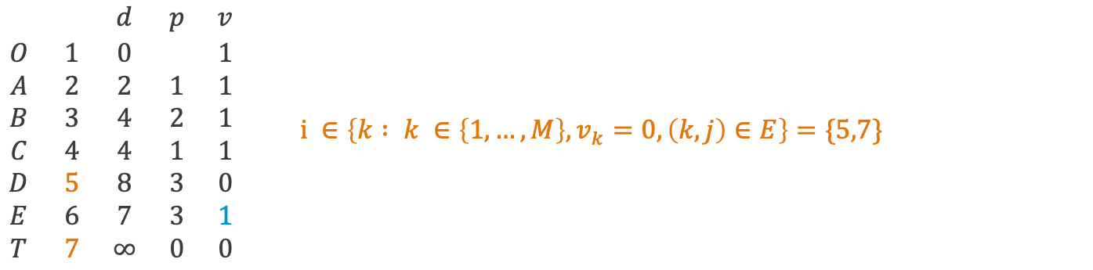
Dijkstra's algorithm – example (step 19)
A
7
2
2
5
T
5
4
B
D
O
1
1
3
7
4
C
3
E
$\begin{matrix} & & d & p & v \\ O & 1 & 0 & & 1 \\ A & 2 & 2 & 1 & 1 \\ B & 3 & 4 & 2 & 1 \\ C & 4 & 4 & 1 & 1 \\ D & 5 & 8 & 3 & 0 \\ E & 6 & 7 & 3 & 1 \\ T & 7 & ∞ & 0 & 0\end{matrix}$ $i ∈\left\{k : k ∈\left\{1,…,M\right\},v_{k}=0, \left(k,j\right)∈E\right\}=\{5,7\}$

Slide 39
Dijkstra's algorithm – example (step 20)
A
7
2
2
5
T
5
4
B
D
O
1
1
3
7
4
C
3
E
$\begin{matrix} & & d & p & v \\ O & 1 & 0 & & 1 \\ A & 2 & 2 & 1 & 1 \\ B & 3 & 4 & 2 & 1 \\ C & 4 & 4 & 1 & 1 \\ D & 5 & 8 & 3 & 0 \\ E & 6 & 7 & 3 & 1 \\ T & 7 & 7+7 & 6 & 0\end{matrix}$ $\begin{matrix}\text{if} d_{j}+w\left(\left(j,i\right)\right)<d_{i} \\ d_{i}= d_{j}+w\left(\left(j,i\right)\right) \\ p_{i}=j\end{matrix}$

Slide 40
Dijkstra's algorithm – example (step 21)
A
7
2
2
5
T
5
4
B
D
O
1
1
3
7
4
C
3
E
$\begin{matrix} & & d & p & v \\ O & 1 & 0 & & 1 \\ A & 2 & 2 & 1 & 1 \\ B & 3 & 4 & 2 & 1 \\ C & 4 & 4 & 1 & 1 \\ D & 5 & 8 & 3 & 1 \\ E & 6 & 7 & 3 & 1 \\ T & 7 & 14 & 6 & 0\end{matrix}$ $\begin{matrix}j∈argmin\left\{d_{k} : k ∈\left\{1,…,M\right\}, v_{k}=0\right\}=\left\{5\right\} \\ v_{j}=1\end{matrix}$

Slide 41
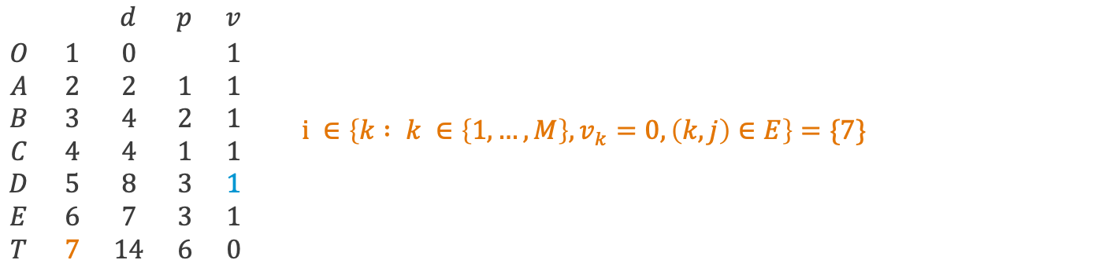
Dijkstra's algorithm – example (step 22)
A
7
2
2
5
T
5
4
B
D
O
1
1
3
7
4
C
3
E
$\begin{matrix} & & d & p & v \\ O & 1 & 0 & & 1 \\ A & 2 & 2 & 1 & 1 \\ B & 3 & 4 & 2 & 1 \\ C & 4 & 4 & 1 & 1 \\ D & 5 & 8 & 3 & 1 \\ E & 6 & 7 & 3 & 1 \\ T & 7 & 14 & 6 & 0\end{matrix}$ $i ∈\left\{k : k ∈\left\{1,…,M\right\},v_{k}=0, \left(k,j\right)∈E\right\}=\{7\}$

Slide 42
Dijkstra's algorithm – example (step 23)
A
7
2
2
5
T
5
4
B
D
O
1
1
3
7
4
C
3
E
$\begin{matrix} & & d & p & v \\ O & 1 & 0 & & 1 \\ A & 2 & 2 & 1 & 1 \\ B & 3 & 4 & 2 & 1 \\ C & 4 & 4 & 1 & 1 \\ D & 5 & 8 & 3 & 1 \\ E & 6 & 7 & 3 & 1 \\ T & 7 & 8+5 & 5 & 0\end{matrix}$ $\begin{matrix}\text{if} d_{j}+w\left(\left(j,i\right)\right)<d_{i} \\ d_{i}= d_{j}+w\left(\left(j,i\right)\right) \\ p_{i}=j\end{matrix}$

Slide 43
Dijkstra's algorithm – example (step 24)
A
7
2
2
5
T
5
4
B
D
O
1
1
3
7
4
C
3
E
$\begin{matrix} & & d & p & v \\ O & 1 & 0 & & 1 \\ A & 2 & 2 & 1 & 1 \\ B & 3 & 4 & 2 & 1 \\ C & 4 & 4 & 1 & 1 \\ D & 5 & 8 & 3 & 1 \\ E & 6 & 7 & 3 & 1 \\ T & 7 & 13 & 5 & 1\end{matrix}$ $\begin{matrix}j∈argmin\left\{d_{k} : k ∈\left\{1,…,M\right\}, v_{k}=0\right\}=\left\{7\right\} \\ v_{j}=1\end{matrix}$

Slide 44
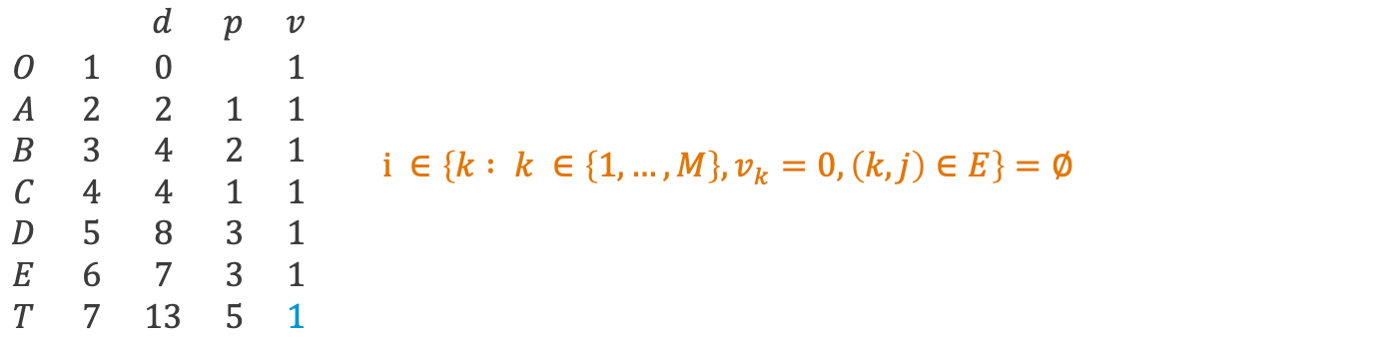
Dijkstra's algorithm – example (step 25)
A
7
2
2
5
T
5
4
B
D
O
1
1
3
7
4
C
3
E
$\begin{matrix} & & d & p & v \\ O & 1 & 0 & & 1 \\ A & 2 & 2 & 1 & 1 \\ B & 3 & 4 & 2 & 1 \\ C & 4 & 4 & 1 & 1 \\ D & 5 & 8 & 3 & 1 \\ E & 6 & 7 & 3 & 1 \\ T & 7 & 13 & 5 & 1\end{matrix}$ $i ∈\left\{k : k ∈\left\{1,…,M\right\},v_{k}=0, \left(k,j\right)∈E\right\}=∅$

Slide 45
Minimal spanning and shortest path trees in Matlab (see OR_Lect_10_networks.m)

Slide 46
Summary and self-study
Summary: today we have learnt:
about graphs and networks,
how to determine the minimal spanning tree of a network,
how to determine the shortest path tree of a network.
Self-study: Find the minimal spanning tree
and the shortest path tree starting at node O
of the network on the right.

